Slide 1
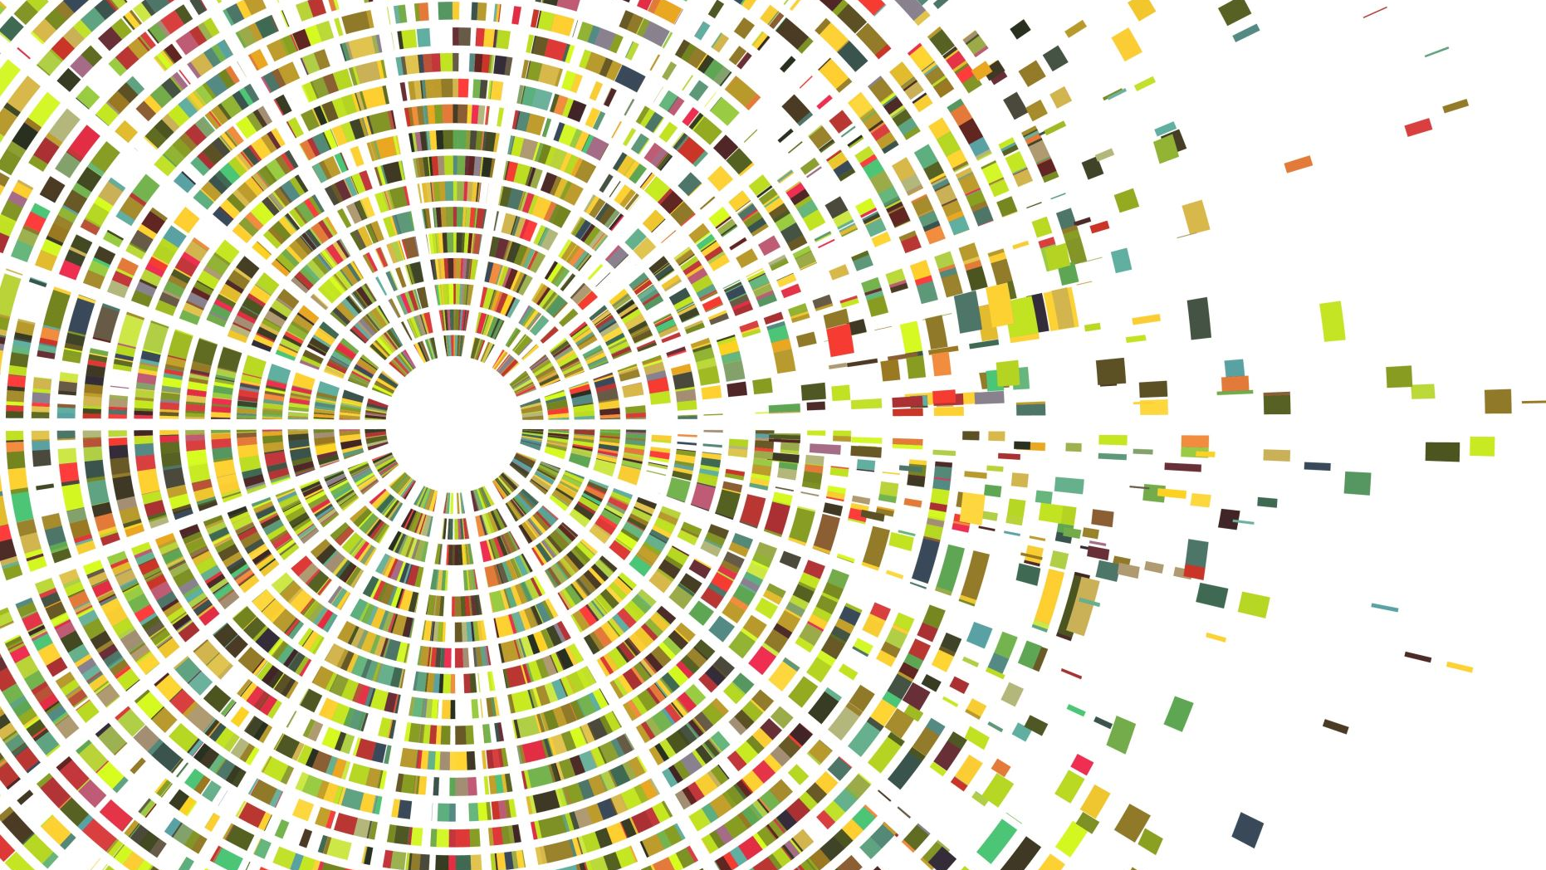
The Urban Tree Canopy of Washington, DC: Distribution of an Urban Resource
AIT 722: Fall 2021. Lensing, Willis

Slide 2
Research Question
Is the urban tree canopy in Washington, DC, equitably distributed?
Notes:
I. Does the proposed project aim to address, solve, or articulate a reasonably-defined S&CC problem? (20%)
Yes. Analyzing the UTC attempts to answer a well-defined question in the S&CC space utilizing data about the citizenry and the urban landscape (UTC).

Slide 3
Background and Motivation
When thinking about smart cities, trees may not be the first to mind. However, trees offer tangible solutions across a wide range of smart city challenges.
The multi-faceted impact of trees on urban challenges makes them an attractive solution for the smart city.
Satellite imaging technology, geographic information systems, and urban arborists (professionals and citizens) performing local street-level inventories make the urban tree canopy a viable solution for addressing smart city challenges.

Slide 4
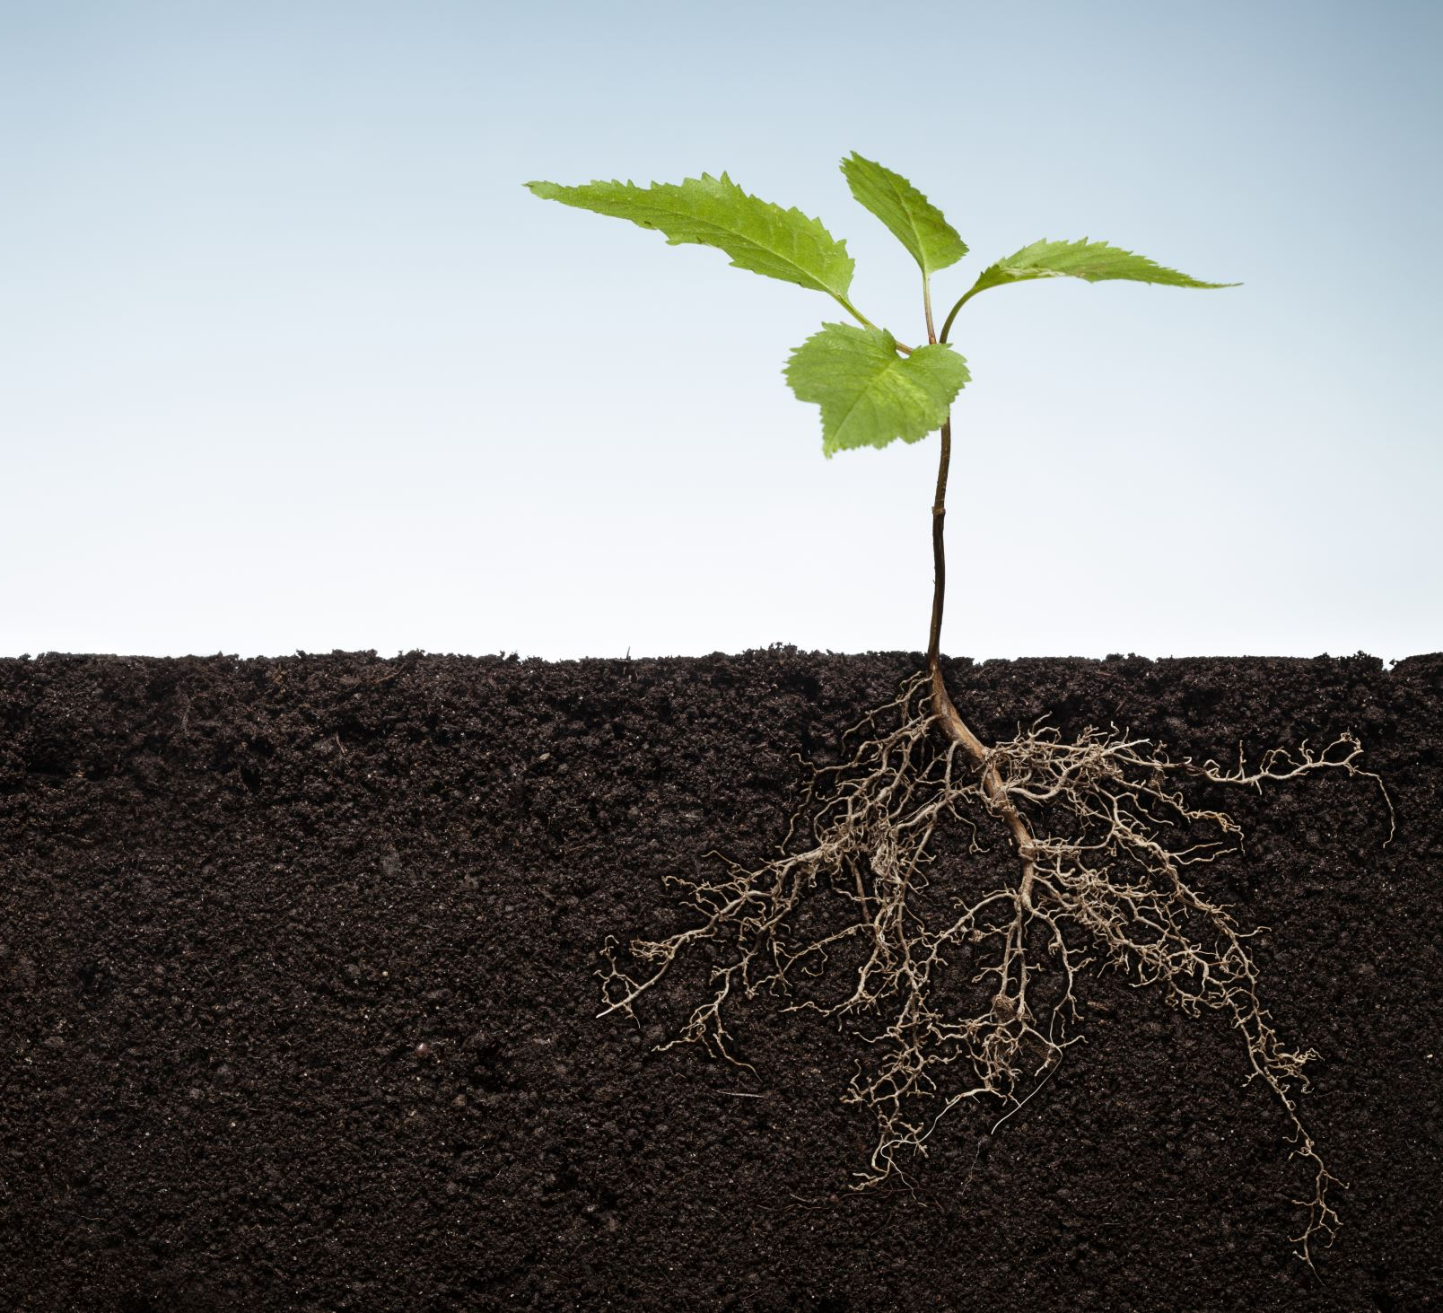
The Urban Tree Canopy (UTC)
Tree cover offers tangible benefits across a wide range of smart city challenges:
Stormwater Management
Pollution Control
Energy Conservation through Heating and Cooling Moderation
Quality of Life
Notes:
IV. Does the proposal provide appropriate justifications for why the proposed S&CC problem is important to the stakeholders? (20%)
Yes. The value of the urban tree canopy is articulated. Further, the relevance of the question – equitable distribution – is an important one to the citizenry and government in a democratic society. Affirming equitable distribution or identifying a gap are both useful outcomes of the study.

Slide 5
Motivation leads to Exploration
We've established the importance and relevance of the tree canopy. What else matters?
The tree canopy matters to the citizenry and to the government officials charged with managing it.
Access matters. In the case of the tree canopy, this means an equitable distribution across the city.
Notes:
II. Does the proposal specify and analyze the potential stakeholder in a justifiable way? (20%)
Yes. The stakeholders are clearly articulated: the citizenry, government administration (Department of Energy and Environment), and policy makers. The topic is relevant to stakeholders and their interest in the question is clear. (also see the slide "data sources" and "process".

Slide 6
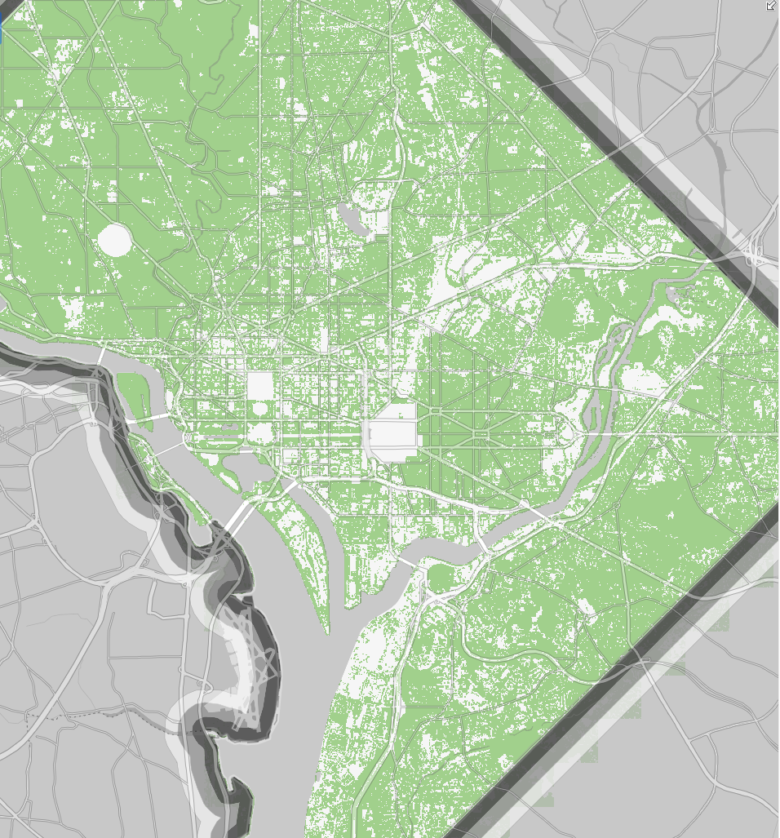
AT LEAST 40% COVER
The non-profit organization American Forests has a specific recommendation for cities like Washington, DC - "forested cities": a target of 40-60% urban tree canopy.
The District has set a target of 40% by 2032.
Notes:
Map from https://dcgis.maps.arcgis.com/home/webmap/viewer.html?webmap=fea6079cf9bc4310a8b6c94f8c2bf1da

Slide 7
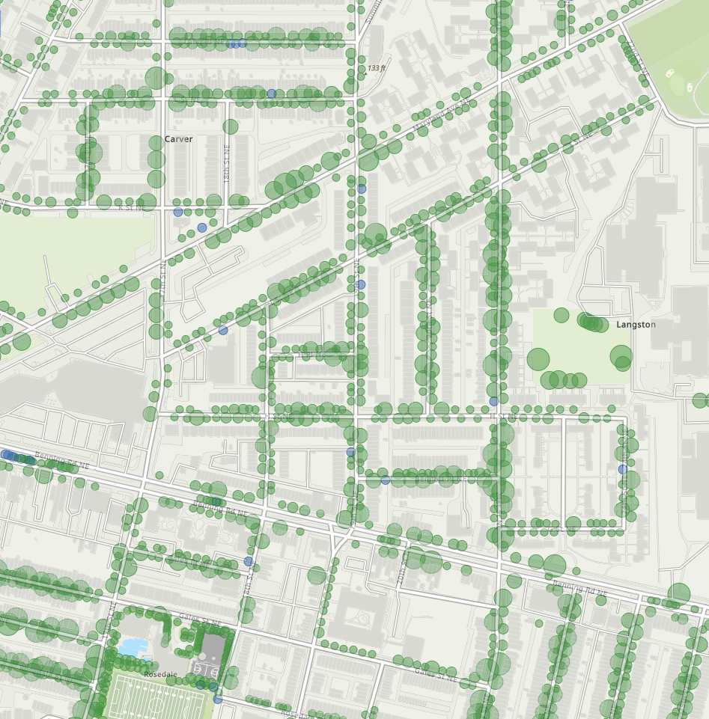
Measuring the Canopy
Measuring the canopy is done at both macro and street-level.
Location, size, and future plantings are tracked.
Aerial views provide a large-scale view of the canopy.
The District's Urban Forestry Division (UFD) tracks trees at as granular a level as the individual tree.
Notes:
Map from https://dcgis.maps.arcgis.com/home/webmap/viewer.html?webmap=fea6079cf9bc4310a8b6c94f8c2bf1da

Slide 8
Data Sources
DC Government's Open Data
Individual tree-level granularity
US Census Data
Zip Code
Block-Level
Suitable and unsuitable land for planting
Notes:
IV. Does the proposal provide reasonable technological or data scientific solutions to address the proposed problem? (20%)
Yes. The approach utilizes appropriate and reputable data sources and a methodology appropriate to the problem domain.

Slide 9
Process
Collection
Cleaning and Data Preparation
Exploratory Data Analysis
Visualizations
Website Deployment

Slide 10
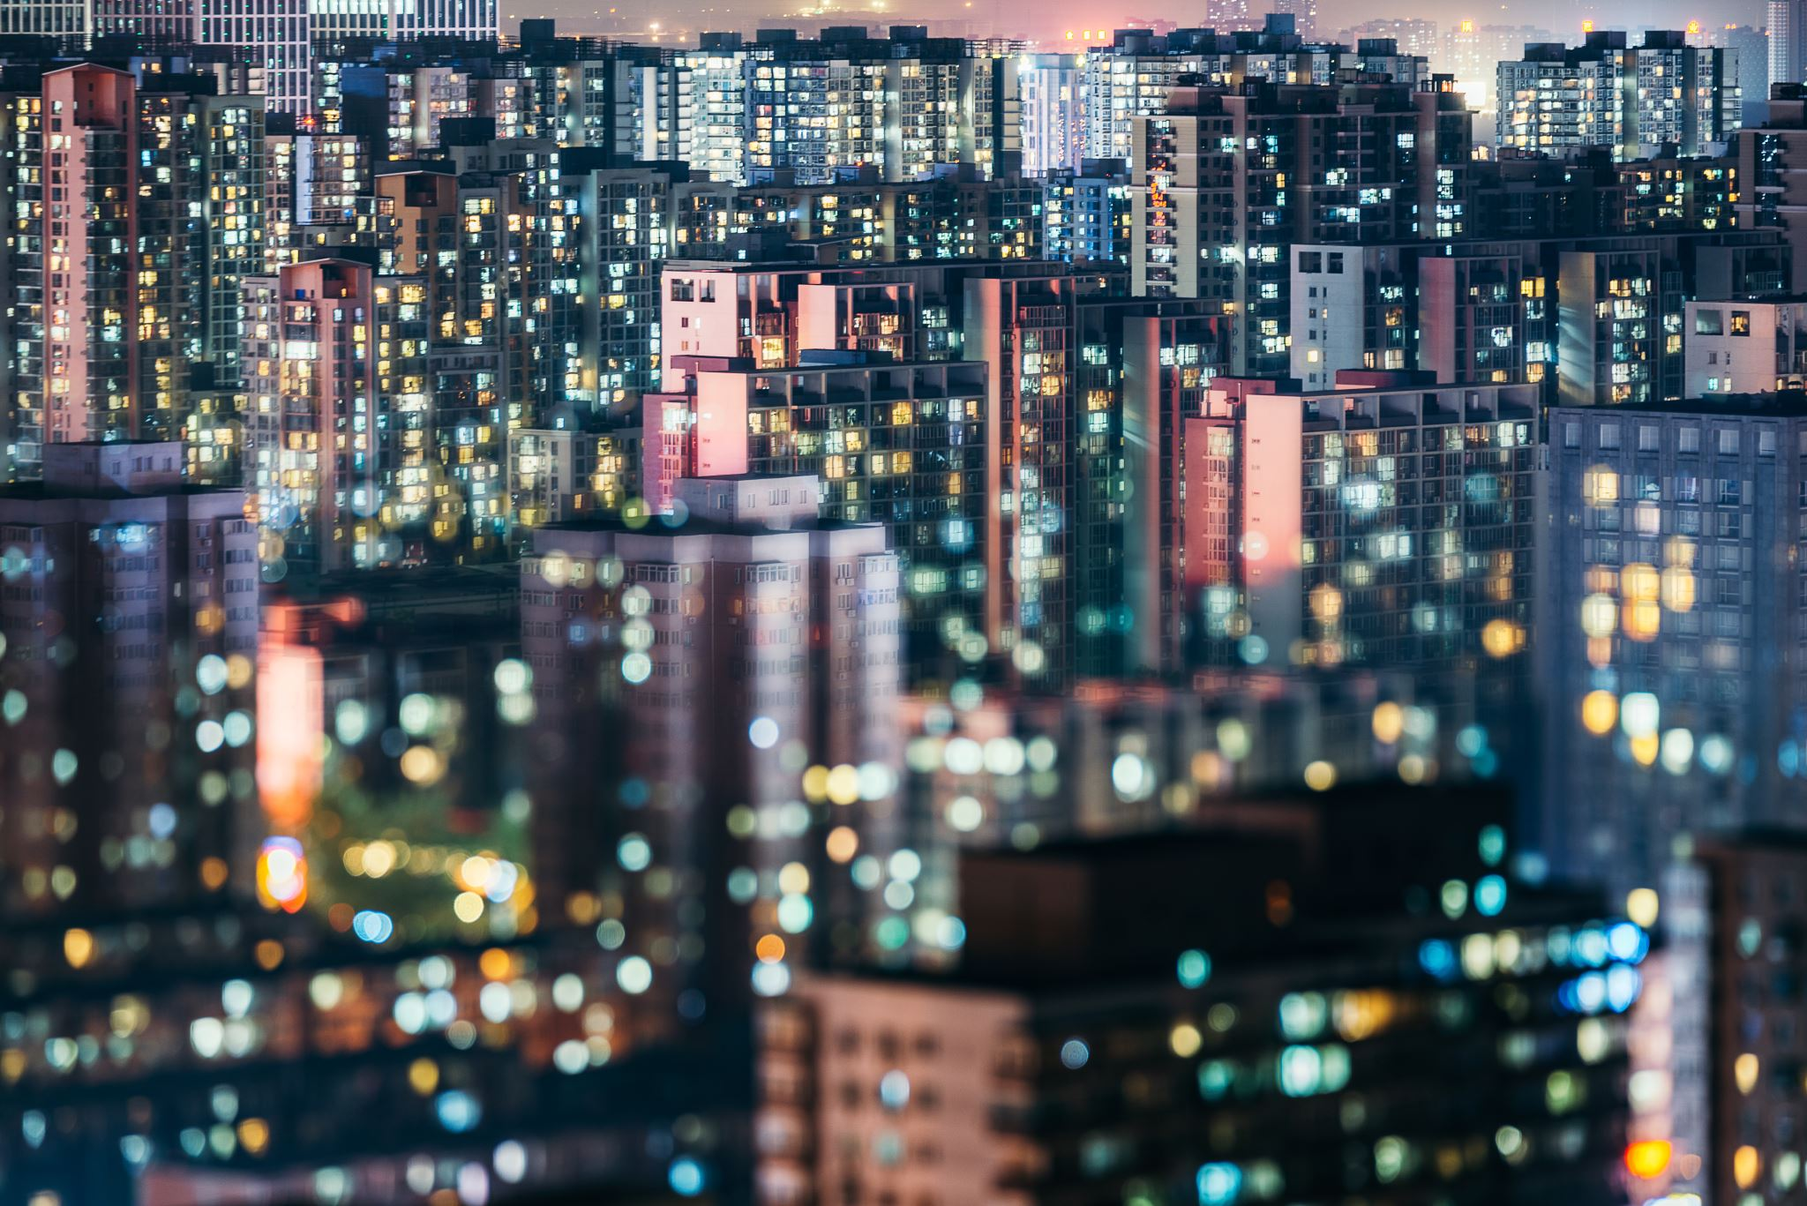
Challenges
53 zip codes in the district, but not all of them are residential
Combining different types of data
Outdated tree canopy data (2015)
Combining very granular data (tree data at the street level) with less granular census data at census block or zip code level

Slide 11
Technology
Python
Pandas
Numpy
GeoPandas
GeoPlot
Jupyter Notebook
Jekyll
Git
R, QGIS for Augmenting Visualization
Data
DC Open Data – CSV, Shape Files, GeoJSON
Census – CSV, API
Less likely, but possible: Natural Earth Data, ESRI ArcGIS Living Atlas, NOAA Weather, NASA SEDAC
Notes:
Are python + bokeh an option for an interactive map? https://towardsdatascience.com/how-to-create-an-interactive-geographic-map-using-python-and-bokeh-12981ca0b567

Slide 12
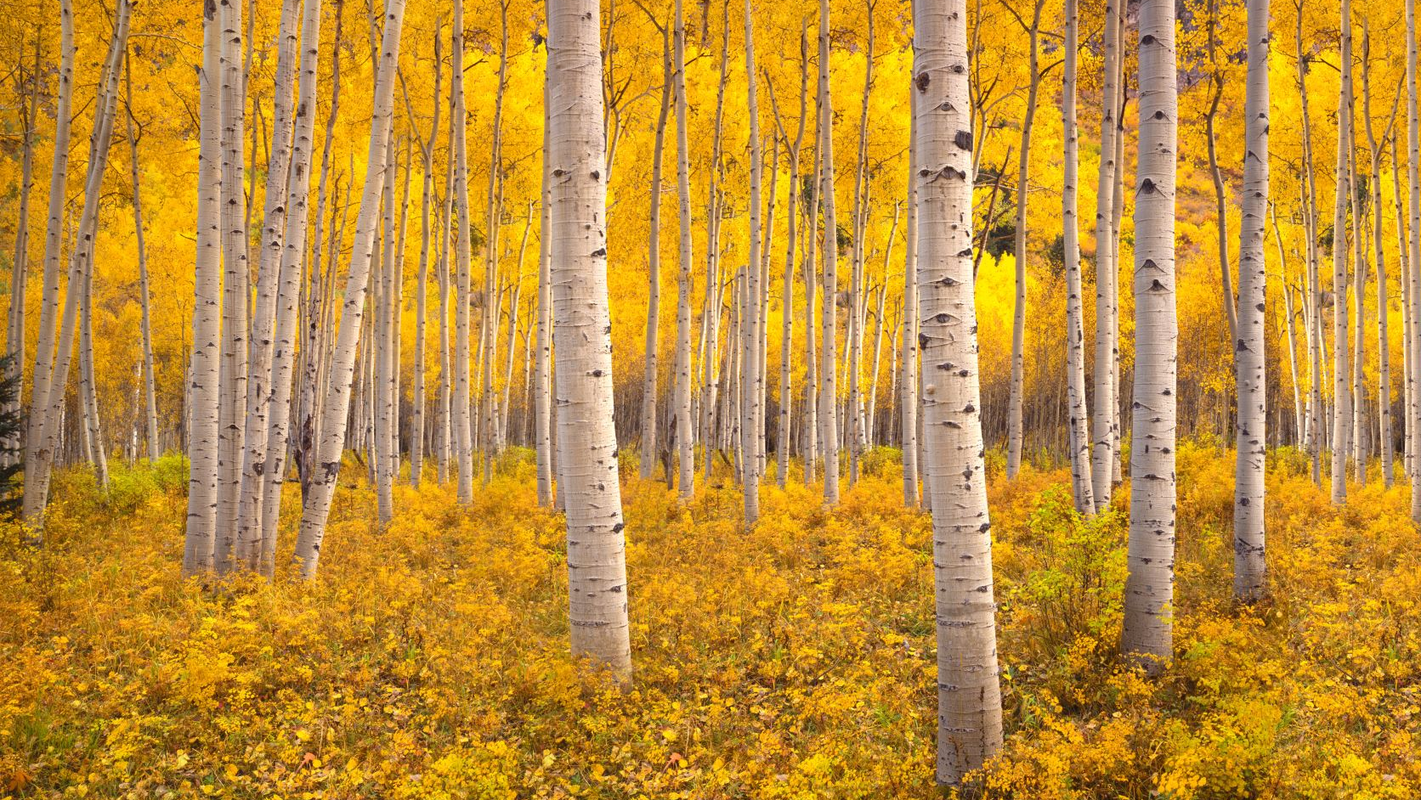
LAYOUT AND ONLINE PRESENTATION
Notes:
V. Does the proposal provide the website layout (low-fidelity design) in a way that would (1) address the proposed problem and (2) appeal to the stakeholders? (20%)
Yes. The layout is consistent with other similar studies. The layout represents an appropriate and attractive combination of results and data sharing with visual appeal.

Slide 13
The Elements of Our Website
Our website incorporates the following key elements:
Background on the problem
Findings
Research results
Visualization of key findings
Geospatial component incorporating different views
Some degree of interactive visualization
Links to additional resources
Notes:
Visualization may be more or less clever depending on our ability to incorporate

Slide 14
Wireframes
On the following pages, we will share our website organization. We will also show wireframes for our proposed website to:
Communicate the direction of the website for feedback
Provide a description of how our research question and results may be shared through a web-based visualization and report

Slide 15
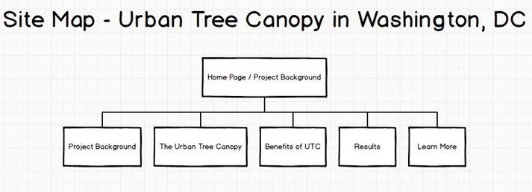
Site Map

Slide 16
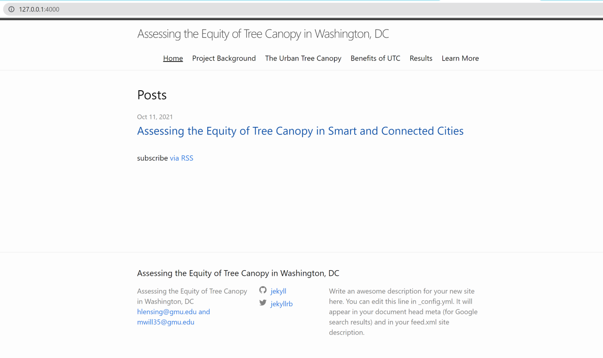

Slide 17
Menu Structure: Background, Motivation, and Results
This organization of content is engaging and logical for addressing our S&CC question. It is modular and organized in a left-to-right manner from "start" to "conclusion."
Content flows from general to more specific, with room for "deeper dives" into other research ("Learn More") and more about the tree canopy.

Slide 18
Site Organization is Driven by Questions
Each top-level page addresses a stated or implicit question:
What is the website about? What S&CC problem are you exploring? ("Project Background")
What is the Urban Tree Canopy (UTC)? ("Urban Tree Canopy")
So what? Why should I care? Why is it important? ("Benefits")
What are the results of the analysis? If there are major benefits from the UTC, then is the distribution equitable? ("Results")
Where can I learn more? ("Learn More")

Slide 19
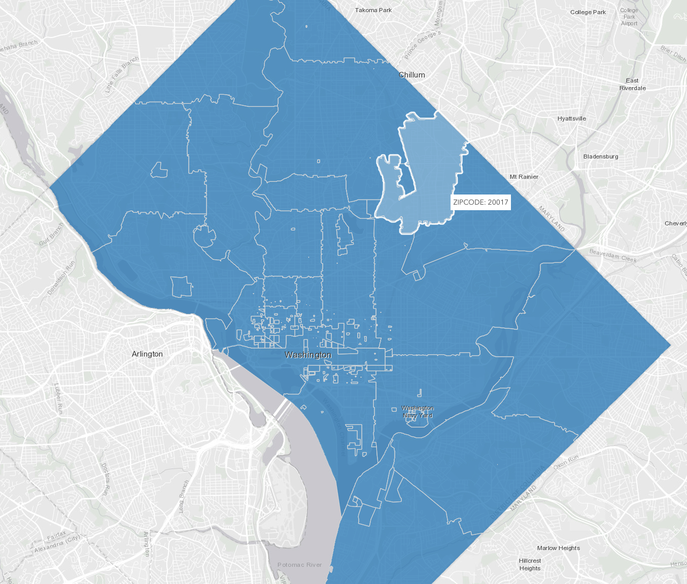
Important Website Elements
Geospatial
Our data are primarily geospatial, so we expect our site will need to provide appropriate visualization of our data and results.
Problem Statement and Background
The Urban Tree Canopy and the connection to S&CC problems needs to be made. We cannot expect a visitor to have prior knowledge. Further, the connection and importance of the question of equitable access must be motivated.
Not Static
Although an interactive capability is not required, we will explore options for incorporating interactivity directly into aspects of visualizing the data. Minimally, we will offer static content in sufficient detail to address our S&CC problem.
Why will our site be better than typical blogs or websites?
We expect it will be because of combination of relevant high-quality content thoughtfully presented with appropriate visualization to explain the problem, our approach, and the results.

Slide 20
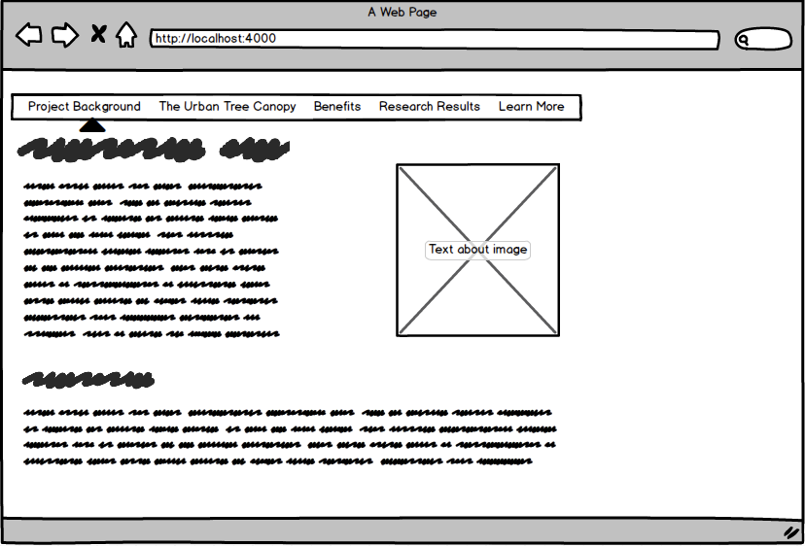
Home Page & Project Background
Location: Home and Project Background
The Home and Project Background pages will be the same. This page provides background on the S&CC problem.
Visuals: visual interest suggesting the combination of urban features from Washington, DC, and the tree canopy.
Content: An overview of the project – a readable "abstract" of the effort and results.

Slide 21
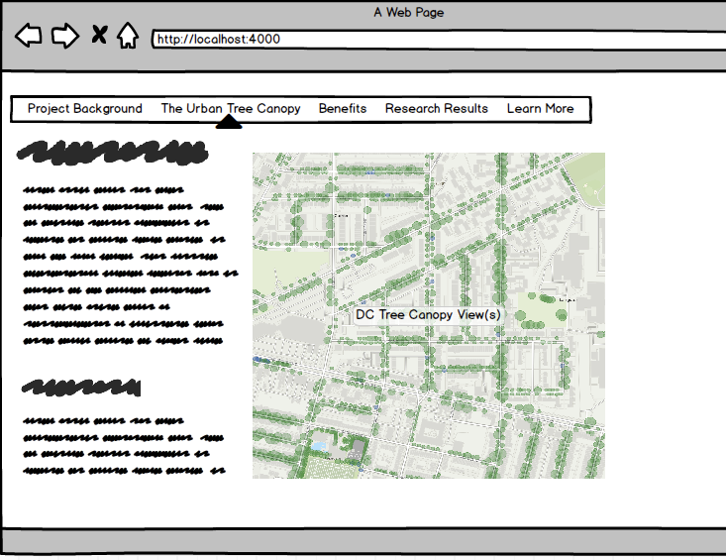
The Urban Tree Canopy
Location: What is the Urban Tree Canopy?
This page explains what the urban tree canopy is and why it matters.
Visuals: visual interest for flavor only
Content: Content explains the UTC

Slide 22
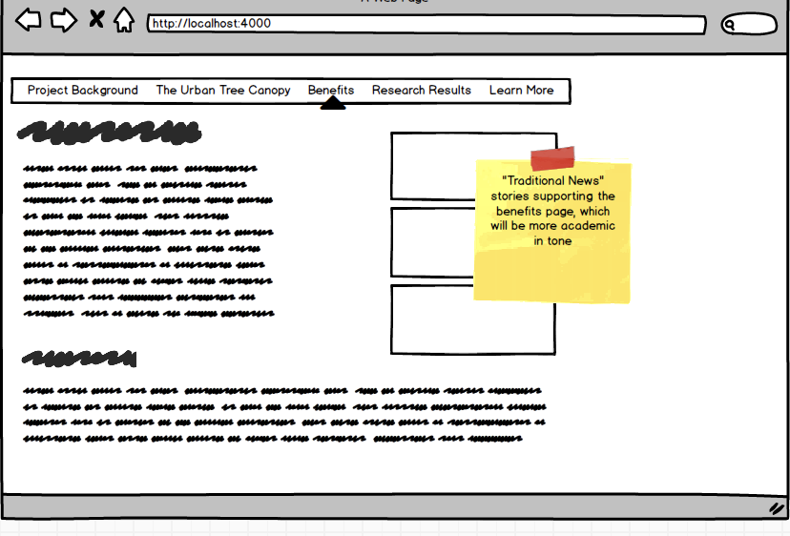
Benefits
Location: Benefits
This page explains the benefits of the urban tree canopy.
Visuals: a visual focus on stormwater issues and cities as "heat islands"
Content: A breakdown of the benefits. Additionally, "in the news" inset will further underscore relevance and impact.

Slide 23
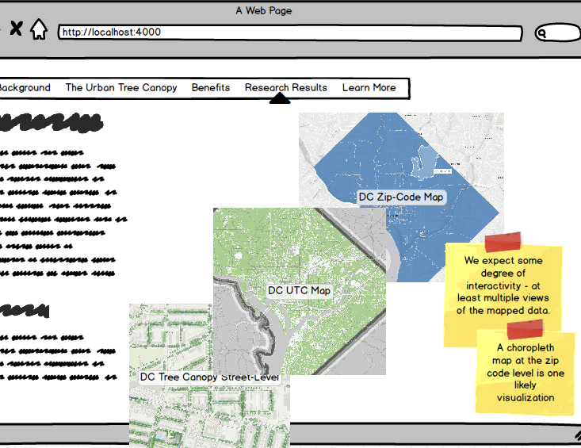
Results
Location: Results
This page will textually provide the results and provide map-based visualization of the data.
Visuals: visual interest will be focused on non-static visualization of results.
Content: "Results" focus

Slide 24
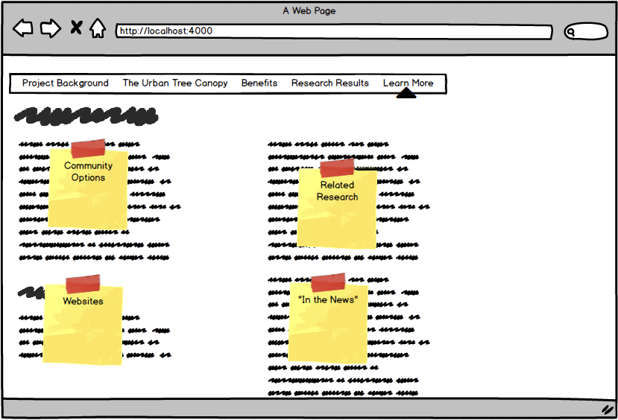
Learn More
Location: Learn More
The Learn More page shares references to other resources, including academic literature, websites, news and local community connections.
Visuals: Limited visual interest on this page.
Content: Links and references to other sites, including local options for engagement.

Slide 25
Questions?

Slide 26
APPENDIX: Mapping the Assignment
Does the proposed project aim to address, solve, or articulate a reasonably-defined S&CC problem? (20%)
Yes. Analyzing the UTC attempts to answer a well-defined question in the S&CC space utilizing data about the citizenry and the urban landscape (UTC).
Does the proposal specify and analyze the potential stakeholder in a justifiable way? (20%)
Yes. The stakeholders are clearly articulated: the citizenry, government administration (Department of Energy and Environment), and policy makers. The topic is relevant to stakeholders and their interest in the question is clear.
Does the proposal provide appropriate justifications for why the proposed S&CC problem is important to the stakeholders? (20%)
Yes. The value of the urban tree canopy is articulated. Further, the relevance of the question – equitable distribution – is an important one to the citizenry and government in a democratic society. Affirming equitable distribution or identifying a gap are both useful outcomes of the study.
Does the proposal provide reasonable technological or data scientific solutions to address the proposed problem? (20%)
Yes. The approach utilizes appropriate and reputable data sources and a methodology appropriate to the problem domain.
Does the proposal provide the website layout (low-fidelity design) in a way that would (1) address the proposed problem and (2) appeal to the stakeholders? (20%)
Yes. The layout is consistent with other similar studies. The layout represents an appropriate and attractive combination of results and data sharing with visual appeal.

Slide 27
Appendix: Starting References
[UNFAO-1] United Nations’ Food and Agriculture Organization. (2016) Benefits of Urban Trees (infographic). http://www.fao.org/3/c0024e/c0024e.pdf
[AF-1] Leahy, I. (2017) Why We No Longer Recommend a 40 Percent Urban Tree Canopy Goal. https://www.americanforests.org/blog/no-longer-recommend-40-percent-urban-tree-canopy-goal/
[DOEE-1] District of Columbia Department of Energy and Environment. (2021, September 12 retrieval) https://doee.dc.gov/trees

Slide 28
Further Reading / Background
Berland, A., et.al. (2017) The role of trees in urban stormwater management. Landscape and Urban Planning (162), 167-177. http://dx.doi.org/10.1016/j.landurbplan.2017.02.017
Tallis, M., et.al. (2011, 30 November) Estimating the removal of atmospheric particulate pollution by the urban tree canopy of London, under current and future environments. Landscape and Urban Planning. (103, Issue 2) 129-138. https://doi.org/10.1016/j.landurbplan.2011.07.003
Nowak, D.J., et. al. (2007) Oxygen Production by Urban Trees in the United States. Arboriculture & Urban Forestry 2007. 33(3):220–226. https://www.nrs.fs.fed.us/pubs/jrnl/2007/nrs_2007_nowak_001.pdf
Ko, Y. (2018, August) Trees and Vegetation for residential energy conservation: A critical review of evidence-based urban greening in North America. Urban Forestry & Urban Greening. (34: August 2018, 318-335). https://doi.org/10.1016/j.ufug.2018.07.021
Leff, M. (2016, September 27) The Sustainable Urban Forest: A Step-by-Step Approach. Davey Institute / USDA Forest Service / USFS Philadelphia Field Station. https://www.itreetools.org/documents/175/Sustainable_Urban_Forest_Guide_14Nov2016.pdf

Slide 29
FURTHER READING / BACKGROUND (2)
Montgomery County Planning (2017, August 18). Tree Canopy Analysis. https://montgomeryplanning.org/planning/environment/forest-conservation-and-trees/tree-canopy-analysis/
O’Neil-Dunne, J. (2011, March 14) A Report on the Montgomery County’s Existing and Possible Tree Canopy. https://www.montgomeryplanning.org/environment/documents/TreeCanopy_Report_MontgomeryCountyFinal.pdf
City of Alexandria Virginia (2019, September 27). Help Grow Alexandria’s Tree Canopy. https://www.alexandriava.gov/recreation/info/default.aspx?id=111539
City of Arlington. (2004) Urban Forest Master Plan. https://arlingtonva.s3.dualstack.us-east-1.amazonaws.com/wp-content/uploads/sites/31/2014/04/Urban-Forest-Master-Plan.pdf

Slide 30
FURTHER READING / BACKGROUND (3)
Maryland Department of Natural Resources (retrieved 2021, September 11). Chesapeake Bay Urban Tree Canopy Goals. https://dnr.maryland.gov/forests/Pages/programs/urban/treecanopygoals.aspx
Teale, C. (2020, October 5) Boston issues RFP for first urban forest plan. Smart Cities Dive. https://www.smartcitiesdive.com/news/boston-design-urban-forest-sustainable-city-plan/586345/
Boston Parks and Recreation (2021, May 21) City of Boston Seeks Partner to Design First Urban Forest Plan. https://www.boston.gov/news/city-boston-seeks-partner-design-first-urban-forest-plan
Alsobrooks, A. Guidelines for Urban Tree Canopy. (retrieved 2021, September 10) Prince George’s County Department of the Environment. https://www.princegeorgescountymd.gov/DocumentCenter/View/32203/Guidelines_Urban-Tree-Canopy

Slide 31
Side Bar: Directions
"Web layout" does not mean that you need to implement work-in-progress websites using Jekyll or other technologies; rather, you need to provide "design" of the rough structure of your future website using hand-sketching or other low-fidelity design tools. This is also called "wireframe." The purpose of making wireframes or layouts before you actually develop the website is (1) to communicate the direction of website design with stakeholders (before it is fully implemented, so you don't go towards a wrong direction), and (2) to provide implications/indications about how the proposed problems could be solved/addressed through the web-based visualization/report.
So, the web layout is not just about showing a generic structure of typical websites, but you should justify why the proposed layouts and rough structures could be useful in addressing the S&CC problem in a meaningful way (e.g., a bad example of web layout is to show the locations of "menus", "empty content area", so on in a generic way, which can be applied to any websites. Rather, presenting particular menu structures, visualization contents, navigation techniques, or storyboards in the way that addresses your proposed problem and showing why they're effective than other typical websites would be the key in discussing the web layouts). The key question I would ask when seeing your layout would be "how is it more effective than other typical blogs and websites in solving the problem that you suggested, and why?"
These links could be useful in understanding how wireframes look and why they're needed:
https://en.wikipedia.org/wiki/Website_wireframe
https://balsamiq.com/learn/articles/what-are-wireframes/
https://careerfoundry.com/en/blog/ux-design/what-is-a-wireframe-guide/

Slide 32
BEGIN OLD SET – REPLACE?

Slide 33
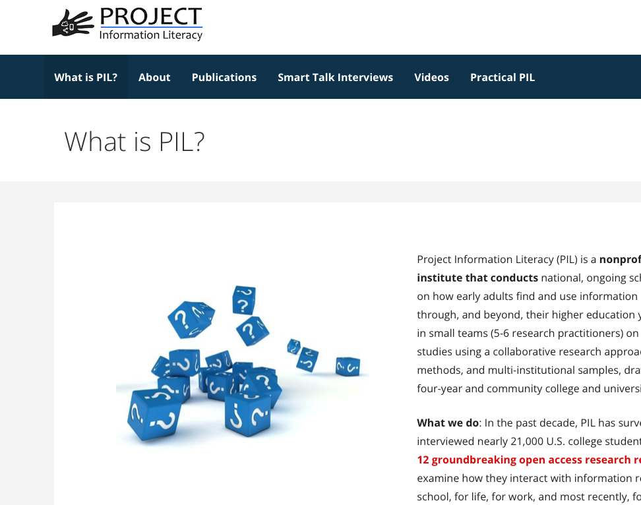
Project Home
** SAMPLE / DRAFT **
Project Home
What is UTC?
Benefits / Value
Washington, DC
The Canopy
Equitable

Slide 34
What is the urban tree canopy?
** SAMPLE / DRAFT **
Project Home
What is UTC?
Benefits / Value
Washington, DC
The Canopy
Equitable

Slide 35
Benefits and Value
** SAMPLE / DRAFT **
Project Home
What is UTC?
Benefits / Value
Washington, DC
The Canopy
Equitable
Stormwater Management
Et harum quidem rerum facilis est et expedita distinctio. Nam libero tempore, cum soluta nobis est eligendi optio, cumque nihil impedit, quo minus id, quod maxime placeat, facere possimus, omnis voluptas assumenda est, omnis dolor repellendus. Temporibus autem quibusdam et aut officiis debitis aut rerum necessitatibus saepe eveniet, ut et voluptates repudiandae sint et molestiae non recusandae. Itaque earum rerum hic tenetur a sapiente delectus, ut aut reiciendis voluptatibus maiores alias consequatur aut perferendis doloribus asperiores repellat.
Pollution Control
Et harum quidem rerum facilis est et expedita distinctio. Nam libero tempore, cum soluta nobis est eligendi optio, cumque nihil impedit, quo minus id, quod maxime placeat, facere possimus, omnis voluptas assumenda est, omnis dolor repellendus. Temporibus autem quibusdam et aut officiis debitis aut rerum necessitatibus saepe eveniet, ut et voluptates repudiandae sint et molestiae non recusandae. Itaque earum rerum hic tenetur a sapiente delectus, ut aut reiciendis voluptatibus maiores alias consequatur aut perferendis doloribus asperiores repellat.
Energy Conservation
Et harum quidem rerum facilis est et expedita distinctio. Nam libero tempore, cum soluta nobis est eligendi optio, cumque nihil impedit, quo minus id, quod maxime placeat, facere possimus, omnis voluptas assumenda est, omnis dolor repellendus. Temporibus autem quibusdam et aut officiis debitis aut rerum necessitatibus saepe eveniet, ut et voluptates repudiandae sint et molestiae non recusandae. Itaque earum rerum hic tenetur a sapiente delectus, ut aut reiciendis voluptatibus maiores alias consequatur aut perferendis doloribus asperiores repellat.
Quality of Life
Et harum quidem rerum facilis est et expedita distinctio. Nam libero tempore, cum soluta nobis est eligendi optio, cumque nihil impedit, quo minus id, quod maxime placeat, facere possimus, omnis voluptas assumenda est, omnis dolor repellendus. Temporibus autem quibusdam et aut officiis debitis aut rerum necessitatibus saepe eveniet, ut et voluptates repudiandae sint et molestiae non recusandae. Itaque earum rerum hic tenetur a sapiente delectus, ut aut reiciendis voluptatibus maiores alias consequatur aut perferendis doloribus asperiores repellat.

Slide 36
Washington, DC
** SAMPLE / DRAFT **
Project Home
What is UTC?
Benefits / Value
Washington, DC
The Canopy
Equitable

Slide 37
Project Home
** SAMPLE / DRAFT **
Project Home
What is UTC?
Benefits / Value
Washington, DC
The Canopy
Equitable

Slide 38
Project Home
** SAMPLE / DRAFT **
Project Home
What is UTC?
Benefits / Value
Washington, DC
The Canopy
Equitable

Slide 39
END OLD SET – REPLACE?

